Slide 1
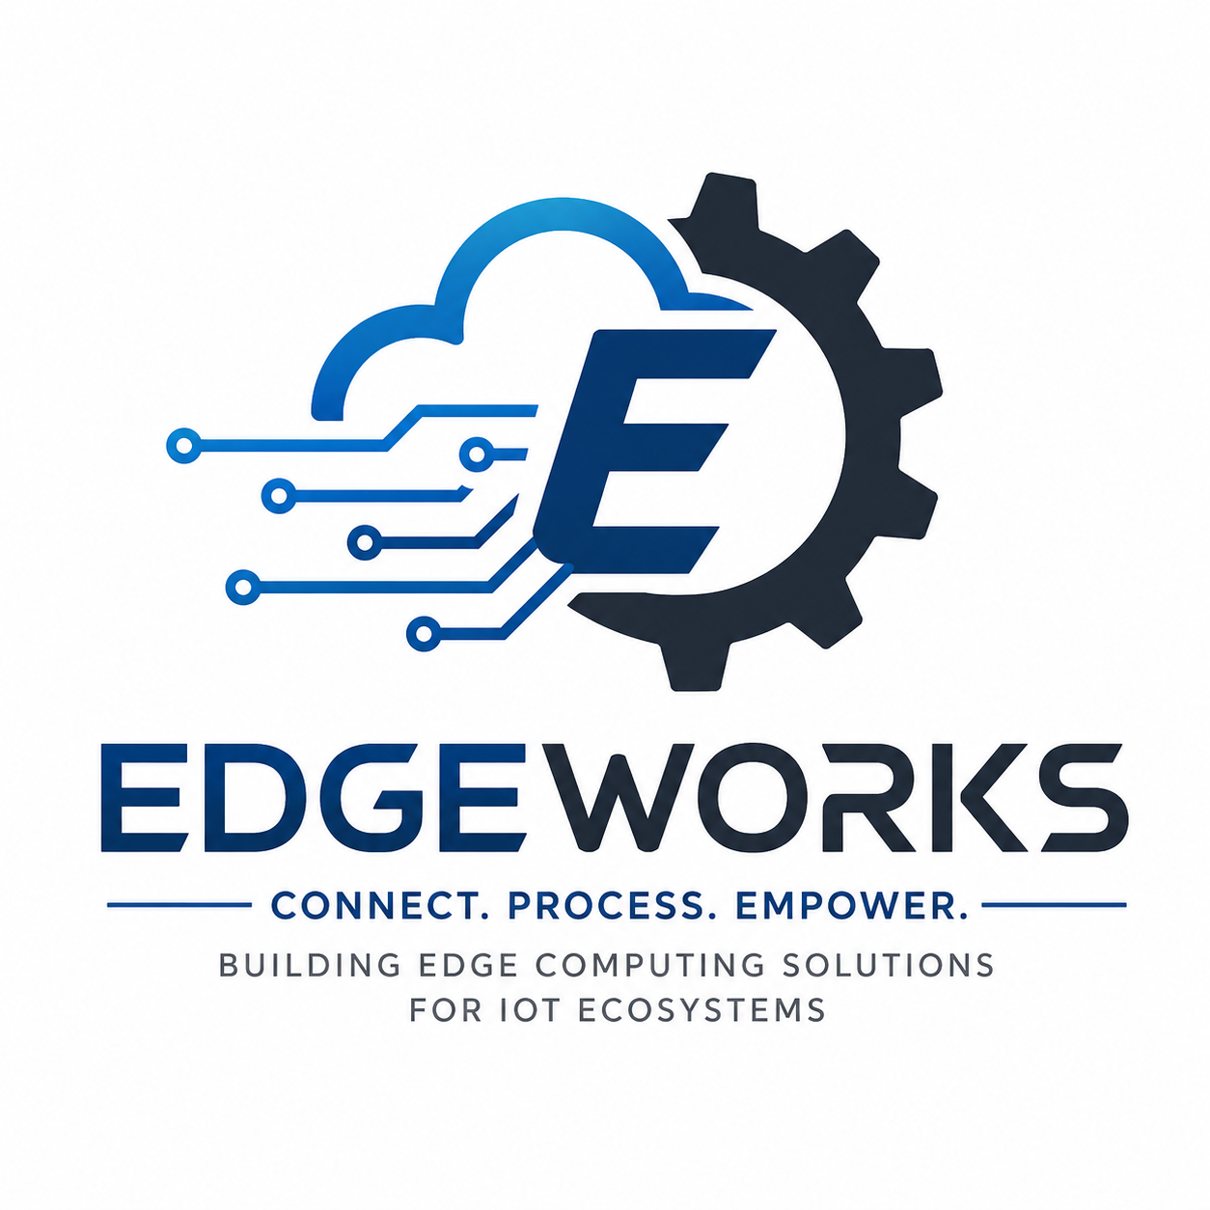
Building Edge Computing Solutions for IoT Ecosystems

Slide 2
About EdgeWorks
Connecting devices, processing data, enabling intelligence at the edge.
• EdgeWorks is a technology service focused on edge computing and IoT ecosystems.
• We bring computation and analytics closer to connected devices and data sources.
• Our approach helps reduce latency, improve responsiveness, and support real-time decisions.
• Solutions are designed with scalability, reliability, and security in mind.
2

Slide 3
The Problem We Solve
Traditional cloud-only IoT architectures can create delays and connectivity challenges.
Latency
Sending every event to a distant cloud can slow time-critical decisions.
Bandwidth
Large volumes of sensor data can increase network usage and cost.
Reliability
Connectivity interruptions can affect cloud-dependent operations.
Security
Sensitive device data needs stronger control and protection.
3

Slide 4
Our Services
Practical solutions for connected devices and intelligent edge environments.
IoT Device Integration
Connect sensors, machines, gateways, and smart devices.
Edge Computing
Run workloads closer to where data is generated.
Real-Time Analytics
Analyze events locally for faster operational decisions.
Edge Security
Protect devices, workloads, data, and communications.
Monitoring & Management
Track device health and manage distributed edge infrastructure.
Scalable Architecture
Design solutions that can grow with business and device demand.
4

Slide 5
How EdgeWorks Works
A simple edge-to-cloud flow for IoT ecosystems.
1
2
3
4
Devices
Sensors and machines generate data.
Edge Gateway
Data is filtered, processed, and analyzed locally.
Intelligence
Rules and analytics trigger rapid actions.
Cloud
Selected data is stored, visualized, or used for deeper analytics.
5

Slide 6
Vision & Mission
VISION
To build a smarter, faster, and more connected world through innovative edge computing solutions, enabling IoT ecosystems to process data closer to where it is generated and make intelligent decisions in real time.
MISSION
To develop secure, scalable, and reliable edge computing solutions that connect IoT devices, enable real-time data processing, reduce latency, and help organizations achieve greater efficiency, automation, and intelligent decision-making.
6

Slide 7
Benefits & Use Cases
Where edge computing can create measurable value.
Smart Manufacturing
Machine monitoring, predictive maintenance, and real-time control.
Smart Buildings
Energy optimization, security, and connected facility management.
Healthcare IoT
Local processing for connected equipment and time-sensitive monitoring.
Retail
In-store analytics, inventory intelligence, and responsive customer experiences.
Transportation
Vehicle, traffic, and infrastructure data processed closer to the source.
Agriculture
Sensor-driven irrigation, environmental monitoring, and automation.
7

Slide 8
EDGEWORKS
Connect. Process. Empower.
• Connect IoT devices and data sources.
• Process information closer to the edge.
• Empower organizations with faster, smarter decisions.
Thank You
8

